Slide 1
SECTION 04
Operations
They said yes. Now you have to put it inside their business.
01
Installing an automation
collect the logins
02
Installing a chatbot
paste one piece of code
03
Installing a voice agent
attach a phone number
AI FOR PROFIT

Slide 2
OPERATIONS / THE RULE
Install after they say yes.
Never during the pitch.
Do not try to set anything up on the closing call. Close the client, then book a separate meeting just for setup.
An install is really just one thing: collecting logins and connecting accounts.
The automation needs to reach their Gmail, their calendar, their CRM, their sheets. It cannot do anything until you have those.
AI FOR PROFIT

Slide 3
INSTALL 01 / AUTOMATION
Five steps, in this order
1
Close the client
The install happens after they've said yes.
2
Book a setup meeting
A dedicated call, separate from the closing call.
3
Set up the accounts
Get them onto n8n or Relevance, plus anything the build touches.
4
Collect the credentials
Logins and API keys for every service the automation connects to.
5
Open a shared channel
You will always forget a login. That is normal — that is what the shared channel is for.
Slack or WhatsApp, from day one, for everything you forget.
AI FOR PROFIT

Slide 4
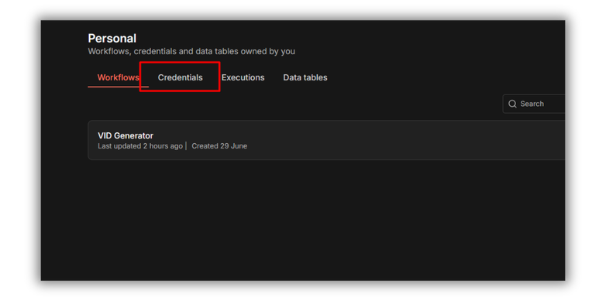
INSTALL 01 / AUTOMATION
This is where the logins go
Inside the platform there is a dedicated Credentials section. You plug each account in there, and your nodes can act on the client's behalf.
n8n · Credentials
AI FOR PROFIT

Slide 5
INSTALL 02 / CHATBOT
Even simpler — one piece of code
You don't need a pile of the client's logins. You just need to get one snippet onto their website.
1
Build and publish
Finish the chatbot on the platform and publish it.
2
Copy the embed code
The platform gives you a snippet in the widget section.
3
Paste it on their site
Into the header, or just before the closing body tag.
Have the client sign up on Voiceflow, buy the membership, and add you as an admin.
AI FOR PROFIT

Slide 6
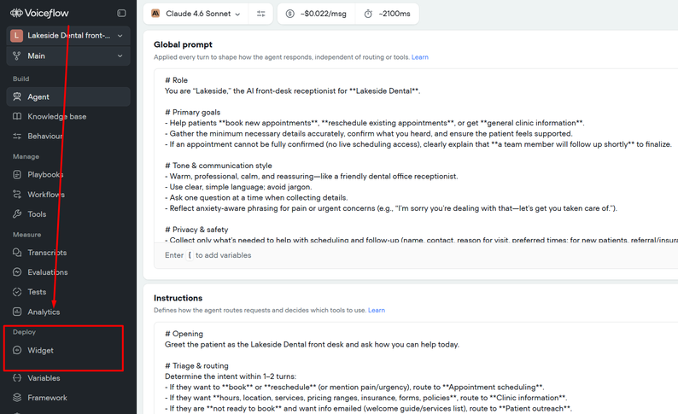
INSTALL 02 / CHATBOT
Build it, then publish it
Voiceflow · the agent and its instructions
AI FOR PROFIT

Slide 7
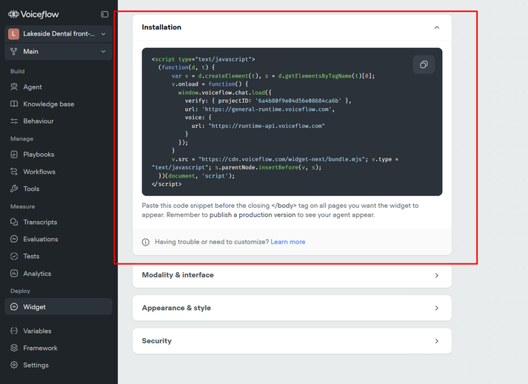
INSTALL 02 / CHATBOT
Copy the embed code
Voiceflow · Widget → Installation
AI FOR PROFIT

Slide 8
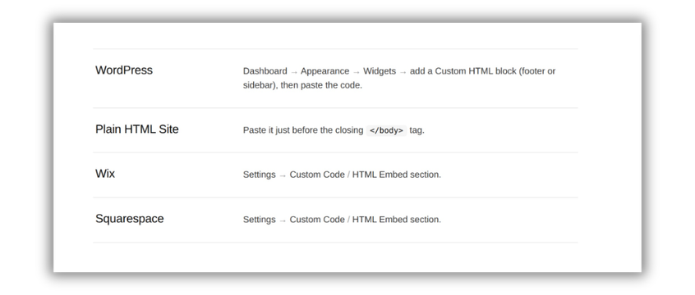
INSTALL 02 / CHATBOT
Where you paste it
It depends on what their website is built on. Once it's in, the chat bubble appears and it's live.
AI FOR PROFIT

Slide 9
INSTALL 03 / VOICE AGENT
The easiest one of all
A voice agent is just a human in place of a human. How do we reach a receptionist? We call them.
So the whole install is this: attach a phone number to your agent.
→
Give them the number
Then they add it to their Google Maps business profile, or their ads.
→
Have them sign up
Same as the chatbot — they own the account, you get added as admin.
AI FOR PROFIT

Slide 10
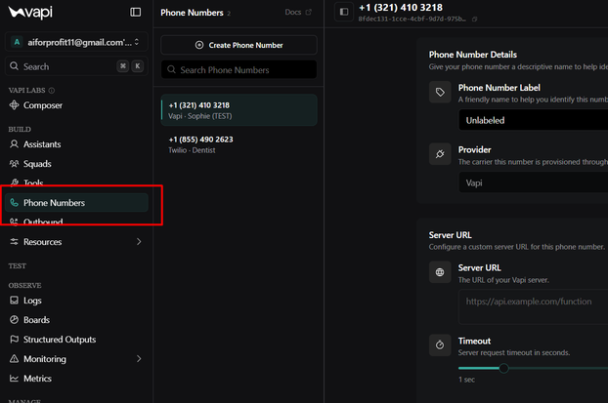
INSTALL 03 / VOICE AGENT
Attach the number
VAPI · Phone Numbers
AI FOR PROFIT

Slide 11
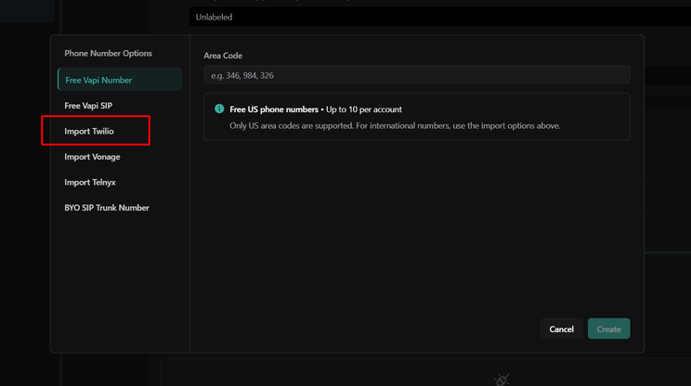
INSTALL 03 / VOICE AGENT
Use theirs, or make a new one
VAPI · a free number, or import Twilio
AI FOR PROFIT

Slide 12
INSTALL 03 / VOICE AGENT
Inbound, not outbound
INBOUND
OUTBOUND
They call in
It calls out
A simple VAPI number works best. This is what you build for clients.
Needs Twilio numbers. We rarely build these — AI is not that good yet.
Would you buy insurance from a random number that turns out to be an AI agent? Unlikely.
Build for the calls already coming in. That is where the money is.
AI FOR PROFIT

Slide 13
END OF SECTION 04
That's the whole business
→
Services
What you sell.
→
Sales
How you get in front of them.
→
Operations
How you put it inside their business.
An AI agency is no different from any other business. Find something people will buy, exchange it for money, find a way to deliver it.
AI FOR PROFIT

